Slide 1

Title: IPL Strategy Analysis & Auction Recommendation for RCB
Prepared by: Negasree Prasath

Slide 2


Content Overview
Introduction
Objectives with Problem Statement
Data Overview
Methodology
Analysis & Key finding
Strategic Recommendations
Conclusion

Slide 3
Introduction
The Royal Challengers Bangalore (RCB) has been a competitive franchise in the IPL. Our analysis focuses on understanding the team's past performance, identifying key players, and optimizing strategies for better results in upcoming seasons. This data-driven approach will guide our insights to enhance team performance and capitalize on strengths.
Key Focus Areas:
Performance analysis across multiple IPL seasons.
Identifying high-performing players based on both batting and bowling metrics.
Analyzing home ground advantage and key matches.
Offering strategic recommendations based on the data.

Slide 4
Objectives
To analyze past RCB performance and identify contributing factors.
To evaluate top-performing players based on batting, bowling, and versatility.
To study the impact of home ground advantage on team performance.
To provide actionable strategies and recommendations to strengthen RCB’s approach.

Slide 5
Problem Statement
RCB is aiming to improve its performance in the IPL and is seeking a comprehensive analysis to identify key players who can contribute effectively to the team’s success. The team wants to focus on the players who perform well consistently, especially those excelling in both batting and bowling. Additionally, understanding team dynamics, home ground advantage, and factors affecting high-scoring matches are crucial for crafting a winning strategy.

Slide 6
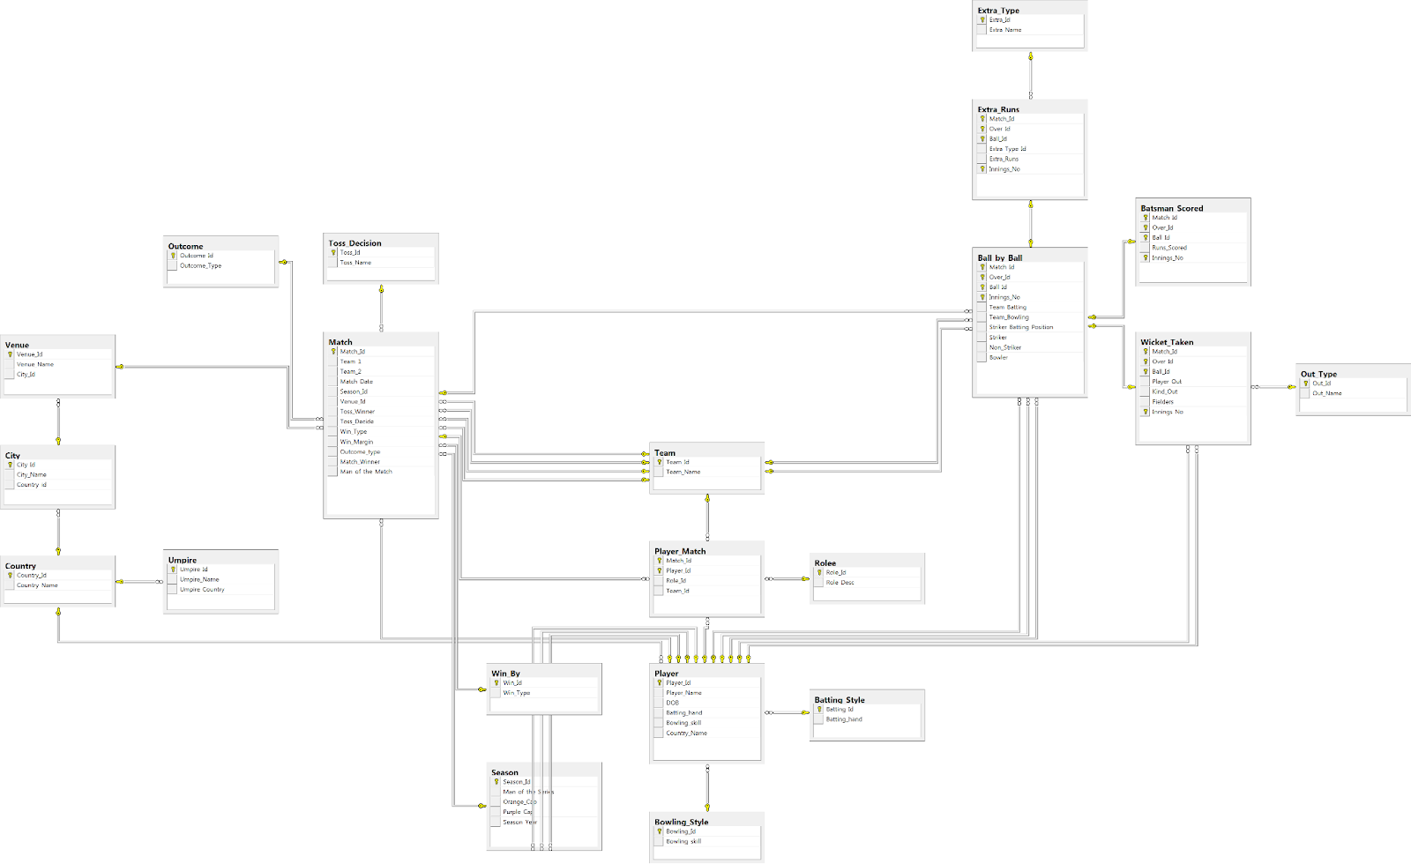
DATABASE SCHEMA

Slide 7

Data Overview
Data Source:
IPL dataset (various tables like matches, player, team, batsman_scored, ball_by_ball).
Key Metrics Analyzed:
Batting performance: Total runs, strike rate, boundaries.
Bowling performance: Wickets taken, economy rate, bowling effectiveness.
Player versatility: Contributions in both batting and bowling.
Team performance: Match wins, home ground impact.
Tools Used:
SQL Workbench for data querying and extraction.
Excel for visualization and in-depth analysis.

Slide 8
Methodology
Step 1:
Data Extraction and preprocessing. Using SQL queries to aggregate batting and bowling performance metrics for individual players.
Identifying player versatility by calculating metrics like strike rate, economy rate, and player impact.
Step 2:
Player Performance Analysis.
Ranking players based on key metrics such as runs scored, wickets taken, strike rate, and economy rate.
Step 3:
Team-Level Insights. Analyzing home ground performance to understand the impact of venue on match outcomes.
Studying historical RCB performance across various seasons.
Step 4:
Recommendations and Strategic Decisions.
Formulating recommendations for RCB based on data-driven insights from player performance and team dynamics.

Slide 9
Analysis & Key finding
Powerplay Performance
Objective:
Identify top-performing batters based on strike rate during Powerplay overs(1-6).
Analysis:
Calculated Strike rate = (runs scored / balls faced) * 100 for players with >20 balls in powerplay. Data is sorted in descending order of strike rate.
Insights:
Highlights aggressive openers.
Useful for team batting order decisions.
Helps identify consistent Powerplay performers.

Slide 10
Analysis & Key finding
Home Ground Performance
Objective:
Analyze RCB's performance at M. Chinnaswamy Stadium and other teams’ home venues.
Analysis:
Calculated win percentage at each venue based on match data.
Insights:
RCB’s home win percentage fluctuates between seasons, highlighting the need for tactical adjustment at home.
Comparison with teams like CSK and MI shows that strong home performance correlates with better overall standings.
RCB has had better results in chasing games at home, with a strong batting lineup taking advantage of the pitch.

Slide 11
Analysis & Key finding
Top Versatile Players
Objective:
Identify players who contribute effectively in both batting and bowling.
Analysis:
Players with high total runs and wicket counts were analyzed for all-round performance.
Insights:
Top all-rounders like Krunal Pandya and Andre Russell offer a unique combination of aggressive batting and effective bowling.
Players who can contribute in both aspects provide valuable flexibility for RCB, especially in situations requiring adaptability.
Such players consistently impact matches through their ability to shift the momentum in both innings.

Slide 12
Analysis & Key finding
Impact of Toss Decision
Objective:
Analyze the influence of toss decisions (batting first or chasing) on match outcomes.
Analysis:
Compared win/loss ratios for teams that chose to bat first versus those that chased.
Insights:
Teams opting to chase generally have a higher win rate, especially at venues like M. Chinnaswamy with smaller boundaries.
RCB performs better when chasing, highlighting the importance of winning the toss and strategic decision-making.
Toss decision impacts performance significantly at high-scoring venues.

Slide 13
Analysis & Key finding
Boundary Frequency
Objective:
Determine which players hit boundaries most frequently and assess their impact on scoring rates.
Analysis:
Calculated the boundary frequency for top batsmen based on balls faced.
Insights:
Power hitters like Chris Gayle and Virat Kohli top the list with a high frequency of boundaries per ball faced.
Players who hit boundaries consistently tend to build rapid scoring momentum, crucial in shorter formats like T20.
RCB can leverage such players to dominate power plays and death overs with aggressive hitting.

Slide 14
Strategic Recommendations
Strengthening Death Over Strategy
Insight:
The death overs (16-20) are where matches can drastically shift, and RCB has faced challenges here, particularly in terms of bowling.
Recommendation:
Prioritize acquiring death-over specialists like Jasprit Bumrah and Chris Morris to control the run flow.
Utilize bowlers with a proven record in the death overs to reduce the opponent’s scoring rate, focusing on tight yorkers and slower balls.
Focus on training existing bowlers like Mohammed Siraj and Harshal Patel to specialize in death-over strategies, leveraging their variations and pace.

Slide 15
Strategic Recommendations
Home Ground Advantage Utilization
Insight:
M. Chinnaswamy Stadium has a reputation as a high-scoring venue, favoring teams with explosive batsmen.
Recommendation:
Strengthen batting depth with power hitters such as Glenn Maxwell and AB de Villiers, capitalizing on the shorter boundaries.
Play to the home advantage by building the team around fast-scoring batsmen and bowlers who are adept at defending in high-scoring scenarios.
RCB should consider chasing more often at home, as they have historically had higher success rates when batting second.

Slide 16
Strategic Recommendations
Prioritize Versatile All-rounders
Insight:
Players who contribute with both bat and ball have a significant impact on team flexibility, particularly in the T20 format.
Recommendation:
Focus on acquiring or retaining versatile all-rounders like Krunal Pandya and Cris Morris, A D Russel, G Maxwel etc who can adapt to both offensive and defensive roles.
Develop current players like Washington Sundar to take on a more versatile role, balancing the team and providing depth in both batting and bowling.
Use versatile players strategically during critical overs to either consolidate batting or break partnerships with bowling.

Slide 17
Conclusion
By focusing on building a team around versatile players and death-over specialists, RCB can address the key challenges that have plagued their performance in past seasons.
Leveraging the home ground advantage, particularly with explosive batting, will significantly increase their chances of winning critical home games.
Strategic acquisition and nurturing of players who can perform under pressure, in both batting and bowling, will elevate RCB to become serious contenders in future IPL seasons.
Consistent execution of these strategies will not only improve RCB's tournament performance but also increase their likelihood of securing a IPL trophy.

Slide 18


